Slide 1
Some Good/Poor Designs

Slide 2
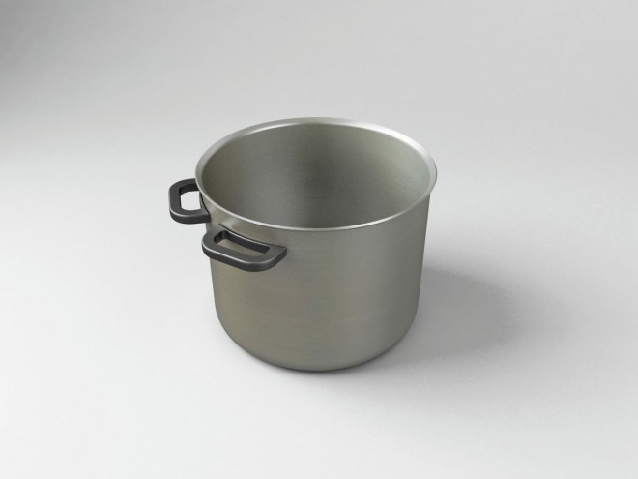

Slide 3
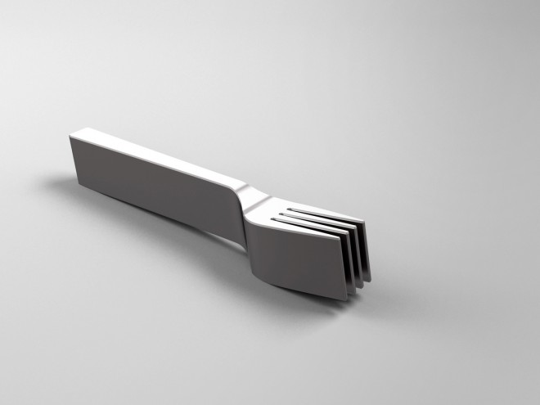

Slide 4
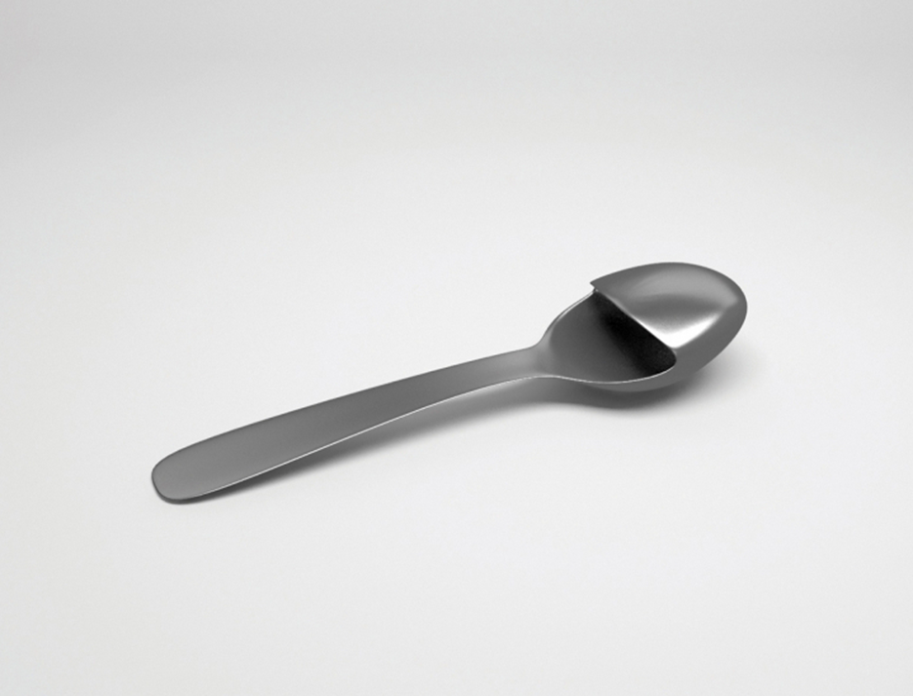

Slide 5
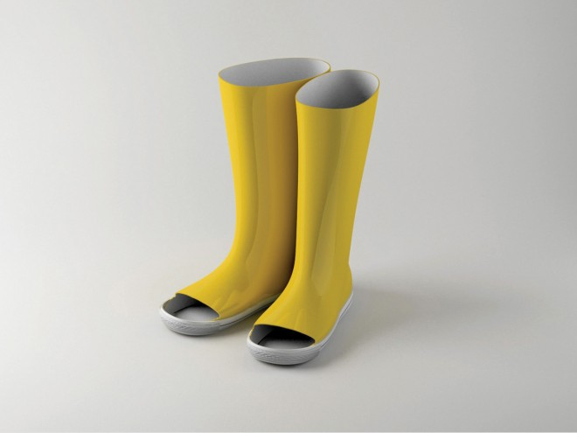

Slide 6
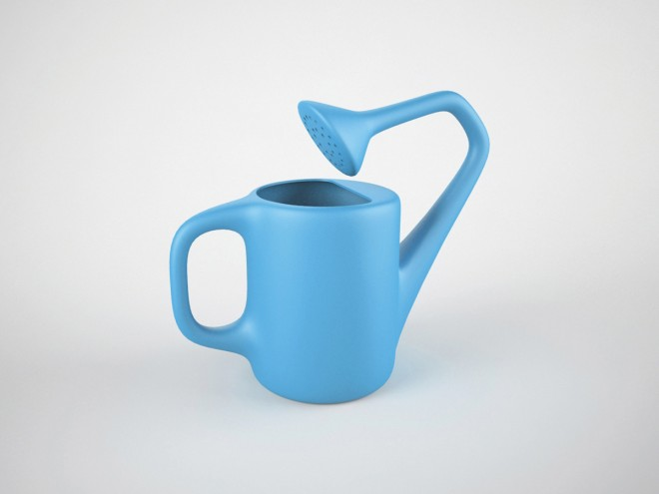

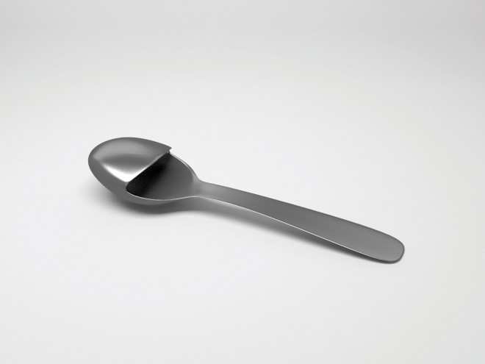
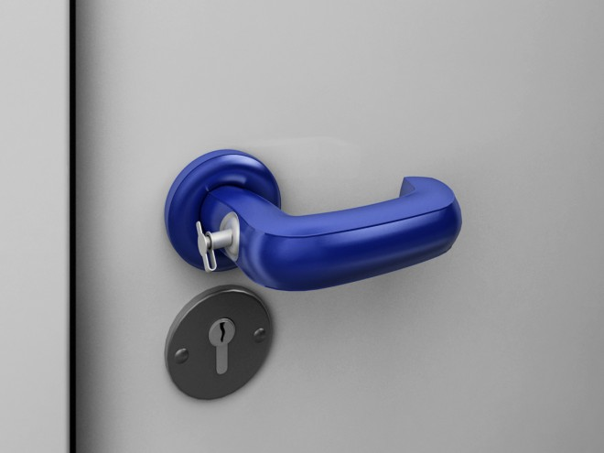

Slide 8


Slide 9
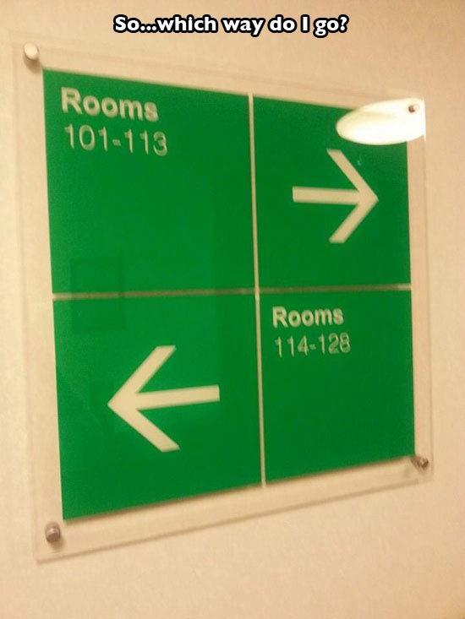

Slide 10
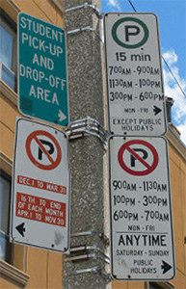

Slide 11
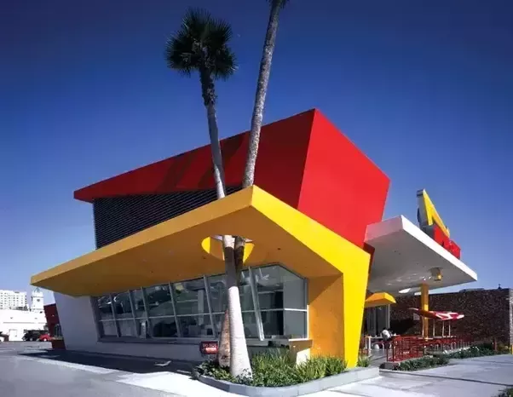
This is not always about good/bad design, it’s about the usable/possible design.. In this case, an Inn ’n’ Out fast food outlet almost never got built because the architect made too good of a design.

Slide 12
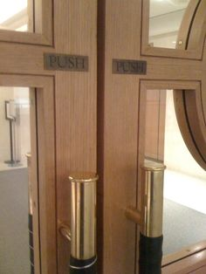

Slide 13
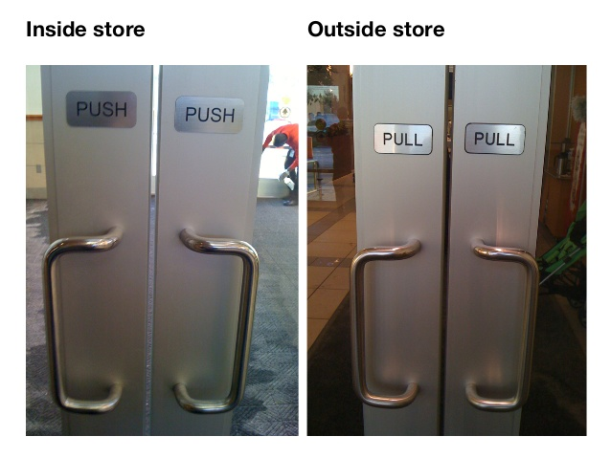

Slide 14
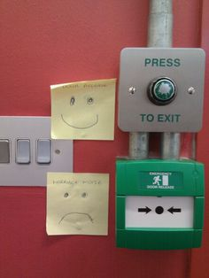

Slide 15


Slide 16
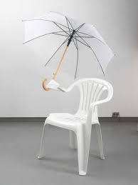
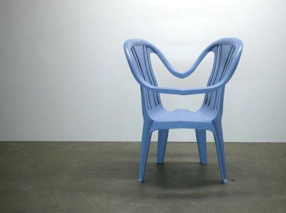

Slide 17
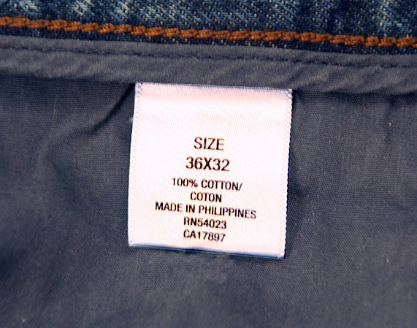

Slide 18
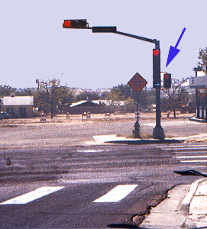
Is that clear that you can turn right when the red lights are on?

Slide 19
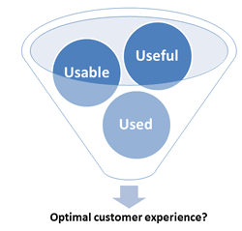

Slide 20
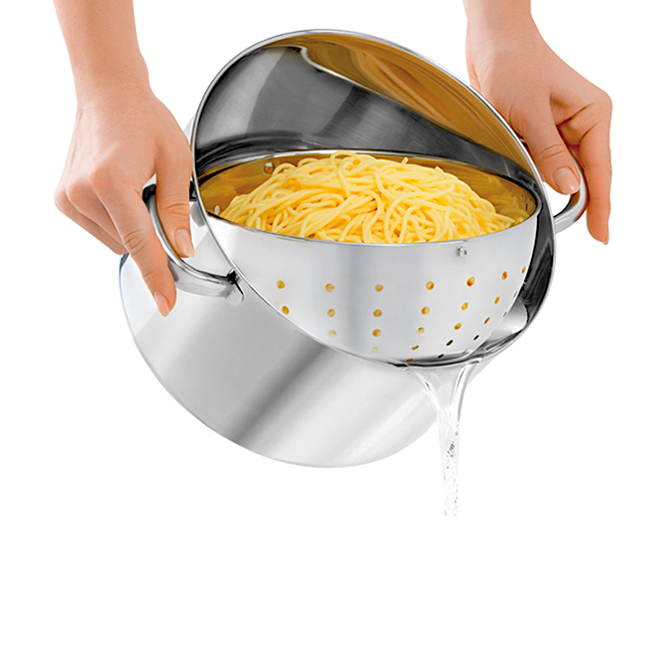

Slide 21


Slide 22
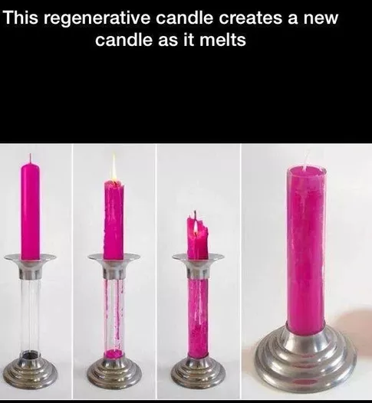

Slide 23
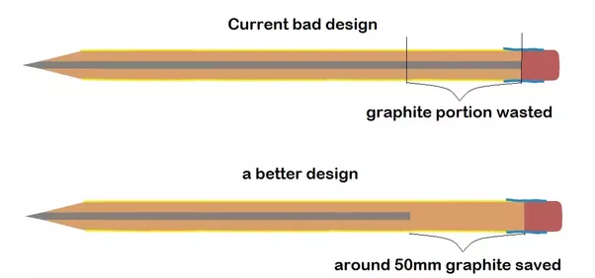

Slide 24
= Desirable ??

Slide 25
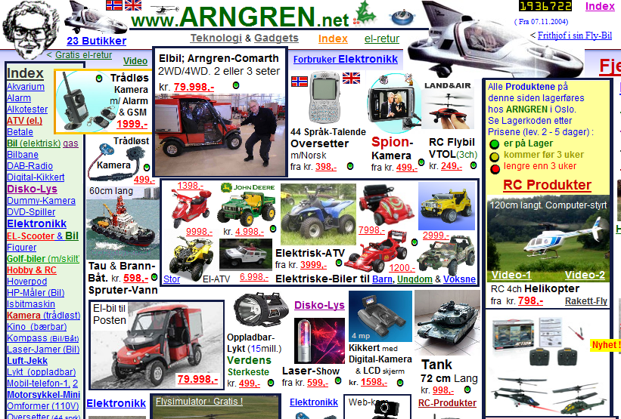

Slide 26
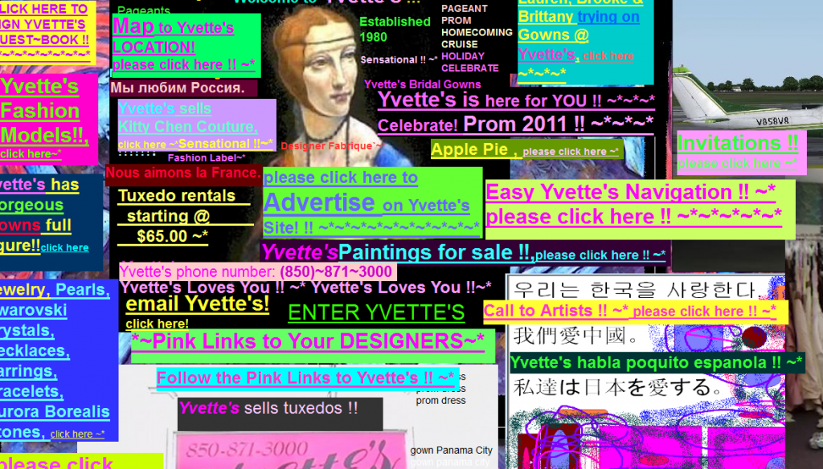

Slide 27
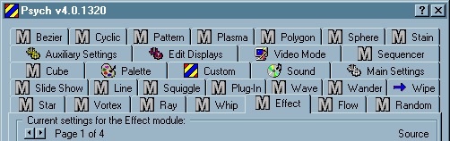
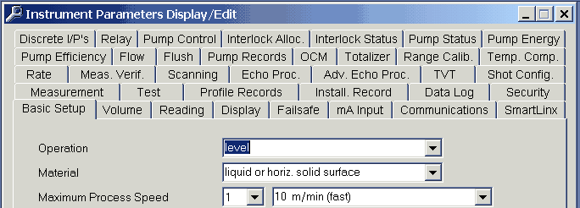
Terrible designs!

Slide 28
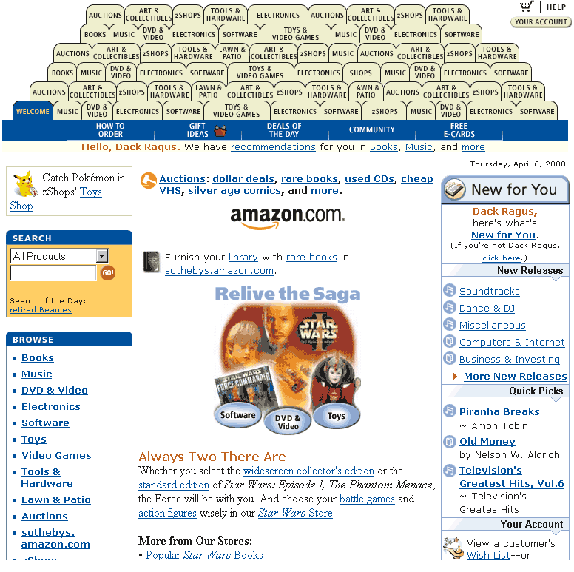
Too many tabs…

Slide 29
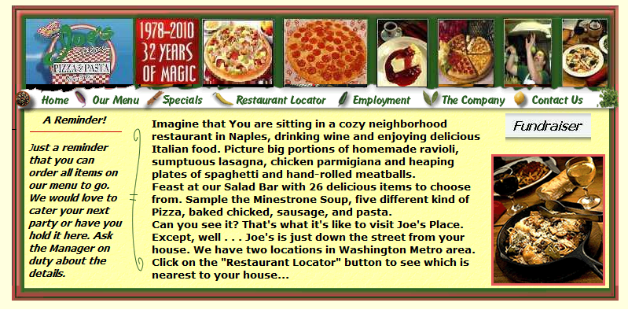

Slide 30
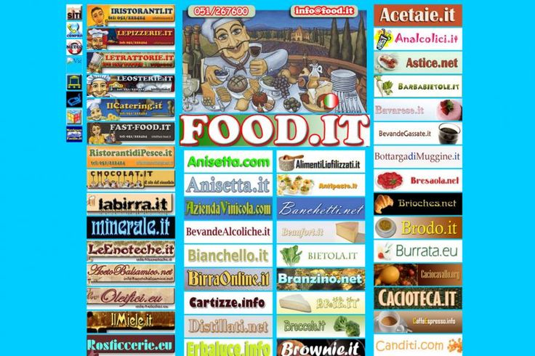

Slide 31
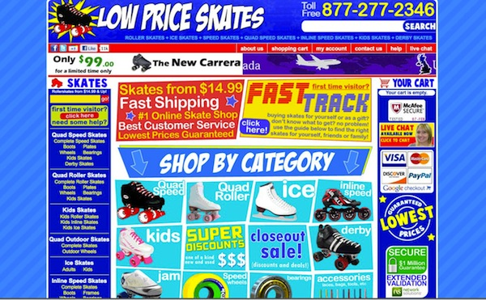

Slide 32


Slide 33
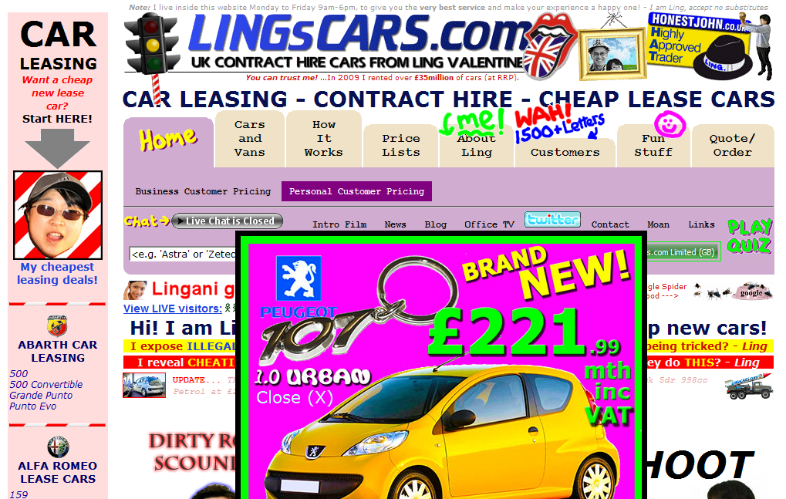

Slide 34
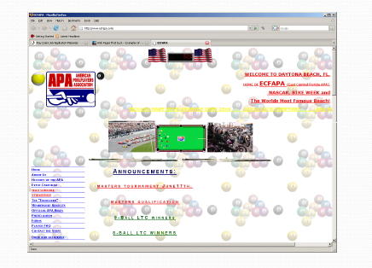

Slide 35
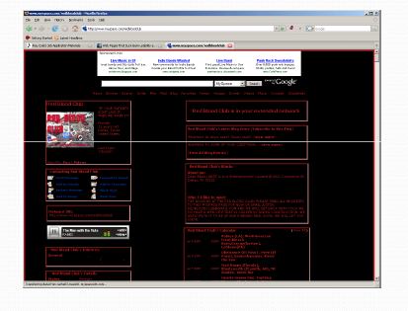

Slide 36
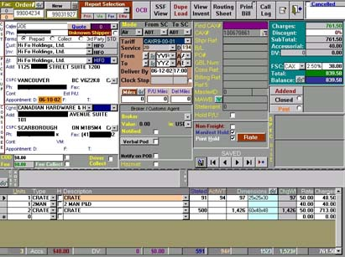

Slide 37
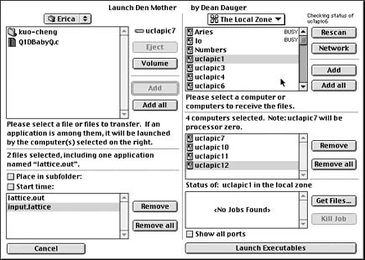

Slide 38
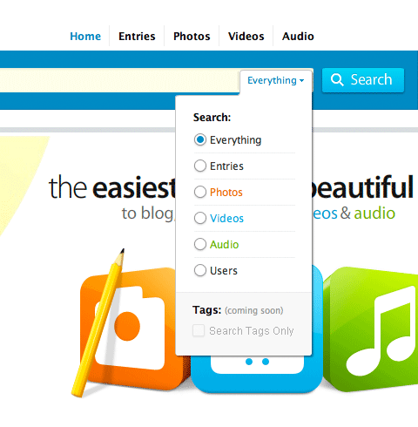

Slide 39
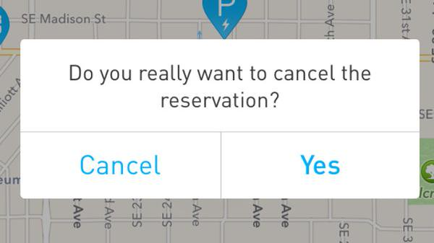

Slide 40
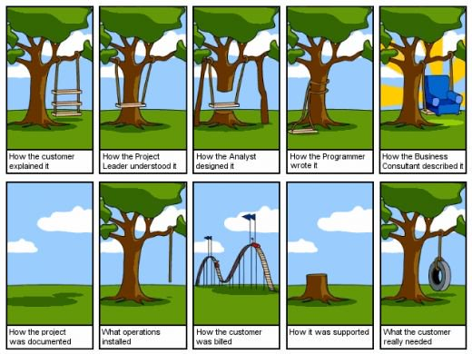

Slide 41
How to Distract screen user??
Common Problems in Visual interface Design
Visual Inconsistency
Lack of restraint in the use of design features and elements
Over-use of three dimensional presentations
Over-use of bright colors
Poorly designed icons
Bad Typography

Slide 42
What Screen Users Want!!
An orderly, clean, clutter-free appearance
An obvious indication of what is being shown and what should be done with it
Expected information located where it should be
A clear indication of what relates to what, including options, headings, captions, data, and so forth
Plain, simple English
A simple way of finding out what is in a system and how to get it out
A clear indication of when an action can make a permanent change in the data or system

Slide 43
User Interface Design
Why design is needed?
Lots of money
Necessity

Slide 44
Assignment 1
ONE innovative designs/ideas
Product/design which is useful, usable and is being used / desirable
Product/design which is useful, usable but not being used

Slide 45
Four Golden Rules
Knowing where you are
State of system – e.g. Downloading now..
Knowing what you can do
Which text is clickable
Knowing where you are going
or what will happen- X-Enter, X-Exit,Icons
Knowing where you’ve been
or what you’ve done

Slide 46
The Gulf of Evaluation and the Gulf of Execution
Two of the many challenges :
gulf of evaluation : Understanding the state of the system
Example: Copying a large number of files
• Large gulf of evaluation: hourglass, spinning pinwheel, no details
• Small gulf of evaluation: progress bar with listing of current file being copied, and estimated completion time
gulf of execution : Taking action to accomplish a specific goal
Large gulf of execution : add item to cart, select checkout, enter shipping address, choose shipping options, enter billing address, enter payment details, accept/decline extra offers, review order, confirm order
Small gulf of execution: Amazon’s 1-Click Ordering

